Slide 1

dssdfv
Samara university
College of engineering and technology
Departement of information tecnology
Group assegment
Course code
Course title
Sumission date
Instructor name

Slide 2
Introduction TCP vs UDP
In this chapter to introduce about tcp and udp detialy such as
Defination of tcp and udp.
Tcp and udp protocol networking.
The difference beetwen tcp and udp.
Some example of tcp and udp.
Application of tcp and udp.

Slide 3
Defination of tcp and udp
Transmission control protocol (TCP) and user datagram protocol (UDP) are foundational pillars of the internet, enabling different types of data transmission from a network source to the destination. TCP is more reliable, while UDP prioritizes speed and efficiency.
The transmission control protocol (TCP) is defined as a connection-oriented communication protocol that allows computing devices and applications to send data via a network and verify its delivery, forming one of the crucial pillars of the global internet.
User datagram protocol (UDP) is a message-oriented communication protocol that allows computing devices and applications to send data via a network without verifying its delivery, which is best suited to real-time communication and broadcast systems.

Slide 4
Difference between tcp &udp
TCP is a connection-oriented protocol, whereas UDP is a connectionless protocol.
The speed for TCP is slower while the speed of UDP is faster
TCP uses handshake protocol like SYN, SYN-ACK, ACK while UDP uses no handshake protocols
TCP does error checking and also makes error recovery, on the other hand, UDP performs error checking, but it discards erroneous packets.
TCP has acknowledgment segments, but UDP does not have any acknowledgment segment.
When we compare TCP vs UDP protocol, TCP is heavy-weight, and UDP is lightweight.
UDP has an 8 bytes fixed-length header. TCP is heavy-weight. UDP is lightweight. TCP doesn't support Broadcasting.

Slide 5
Contn…
TCP is a connection-oriented protocol, whereas UDP is a connectionless protocol. A key difference between TCP and UDP is speed, as TCP is comparatively slower than UDP. Overall, UDP is a much faster, simpler, and efficient protocol, however, retransmission of lost data packets is only possible with TCP.
TCP is suited for applications that require high reliability, and transmission time is relatively less critical. UDP is suitable for applications that need fast, efficient transmission, such as games. UDP's stateless nature is also useful for servers that answer small queries from huge numbers of clients.
the TCP is connection-oriented while UDP is connectionless. In TCP after the connection is set up, bidirectional sending of data is possible but in UDP, packets are sent in chunks. TCP is more reliable than UDP but UDP is faster than TCP.

Slide 6
HOW DOES WORK
UDP works by gathering data in a UDP packet and adding its own header information to the packet. This data consists of the source and destination ports on which to communicate, the packet length and a checksum. After UDP packets are encapsulated in an IP packet, they're sent off to their destinations.
TCP work provides communication between an application program and the Internet Protocol (they are frequently written as TCP/IP.) An application does not need to required packet fragmentation on the transmission medium or other mechanisms for sending data in order to be sent via TCP.

Slide 7
The use of tcp & udp
TCP provides apps a way to deliver (and receive) an ordered and error-checked stream of information packets over the network. The User Datagram Protocol (UDP) is used by apps to deliver a faster stream of information by doing away with error-checking.
TCP stands for Transmission Control Protocol a communications standard that enables application programs and computing devices to exchange messages over a network. It is designed to send packets across the internet and ensure the successful delivery of data and messages over networks. User Datagram Protocol (UDP) refers to a protocol used for communication throughout the internet. It is specifically chosen for time-sensitive applications like gaming, playing videos, or Domain Name System (DNS) lookups.

Slide 8
Some example
Whatsapp, Instagram, Google Chat,iMessage. TCP is used in File transfer when we cannot tolerate the loss of data and receiving the data incorrect order is of utmost importance. FTP uses two TCP connections i.e control connection and data connection.
Udp include Voice over IP (VoIP), online games, and media streaming. Speed – UDP's speed makes it useful for query-response protocols such as DNS, in which data packets are small and transactional.
Example like File Transfer Protocol (FTP), Secure Shell (SSH), and Telnet.

Slide 9
Application of tcp & udp
Tcp
web browsing, email and file transfer are common applications that make use of TCP. TCP is used to control segment size, rate of data exchange, flow control and network congestion. TCP is preferred where error correction facilities are required at network interface level.
Udp
Lossless data transmission. UDP can be used in applications that require lossless data transmission. ...
Gaming, voice and video. ...
Services that don't need fixed packet transmission. ...
Multicasting and routing update protocols. ...
Fast applications.

Slide 10
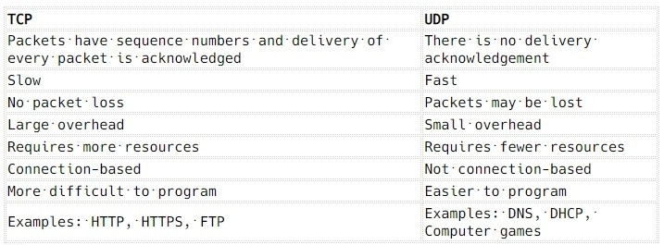
Over all d/t of tcp and udp

Slide 11
End
THANK YOU

